Slide 1
GAN的理论与模型
聂涵韬

Slide 2
问题
如何使GAN的训练收敛？（全靠调参？）
如果GAN的损失函数(loss function)收敛了，那么我们能否保证生成器生成的数据分布逼近了真实数据分布？
如果输入的真实数据有噪声，如何保证GAN的鲁棒性？
如何避免mode collapse？
如何看待GAN？
Notes:
这些问题实际上是互相交融的。我们将从测度和博弈论两种角度解释GAN（第四个问题），同时通过数学证明试图解决第二个问题。
我们采用正则化方法，这对于前四个问题的解决均有帮助。
第一个问题可以被其抽象为一个纯粹的优化问题，然后从优化算法上对平凡的梯度算法做改进。
我们在GAN的理论研究中，通常关心的是GAN的损失函数，而非GAN的模型架构。在这里，我们默认GAN的架构是一个普通的卷积神经网络。
我们研究最多的是WGAN，因为其具有漂亮的数学性质。

Slide 3
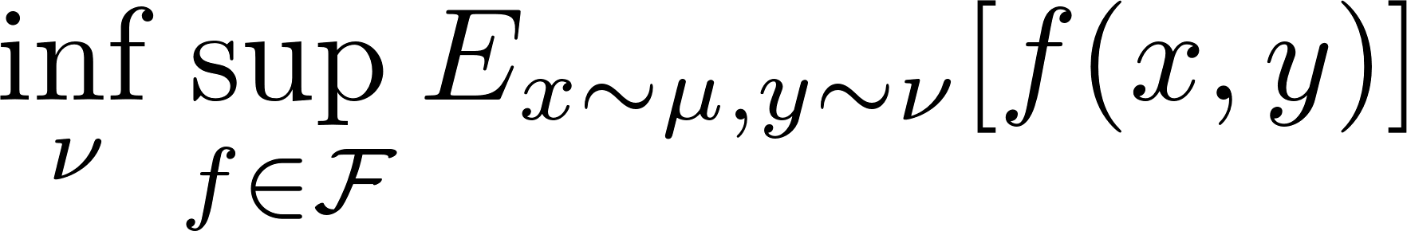
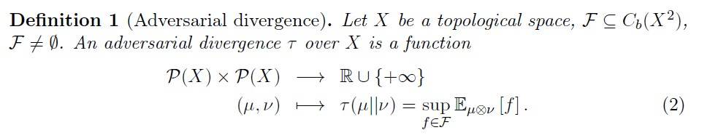
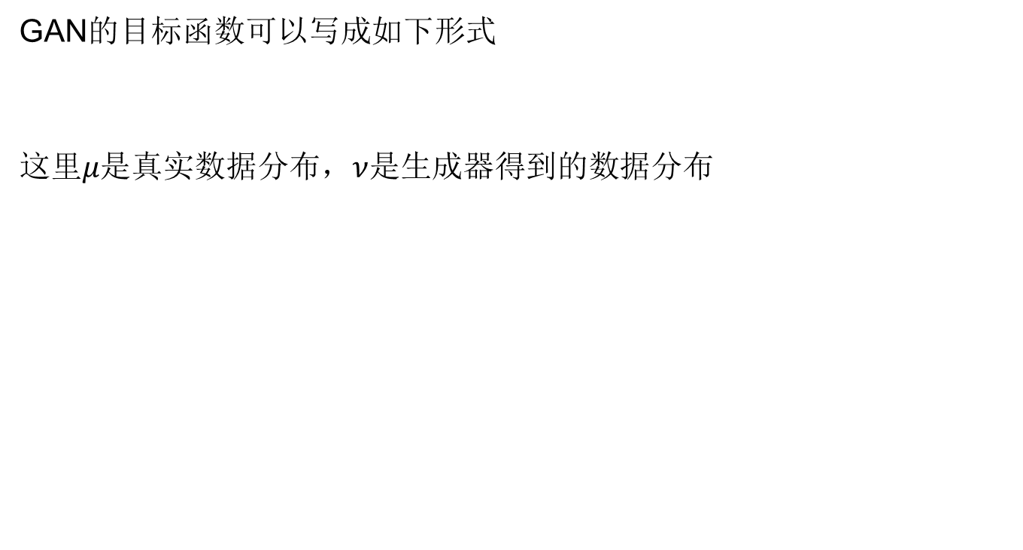
Adversarial divergence
GAN的目标函数可以写成如下形式
这里$μ是$真实数据分布，$ν$是生成器得到的数据分布
Notes:
Approximation and Convergence Properties of Generative Adversarial Learning
这里$C_{b}\left(X^{2}\right)$表示从X到X的有界连续函数（bounded continuous）的集合

Slide 4
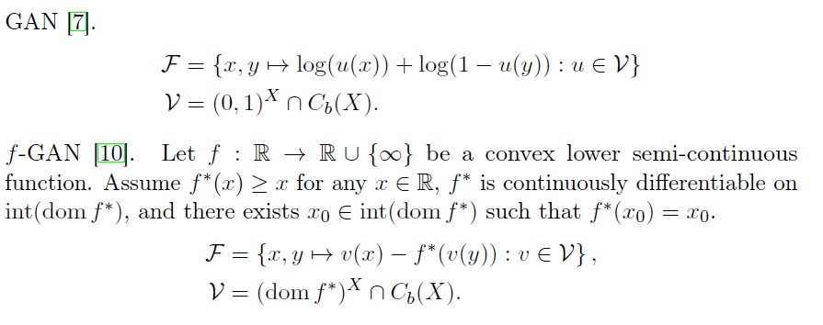
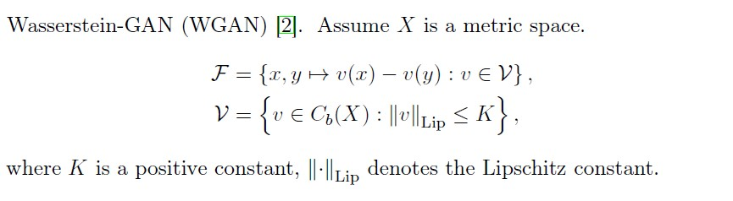
常见模型在adversarial divergency形式下的表示
Notes:
Y^X表示Y到X的函数集合

Slide 5
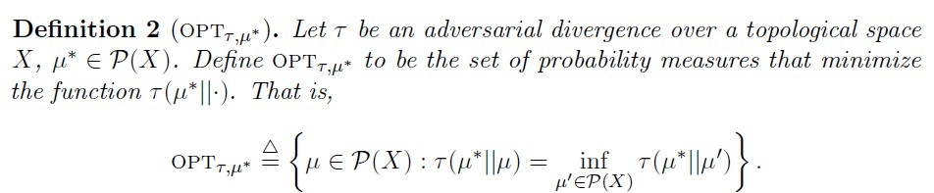
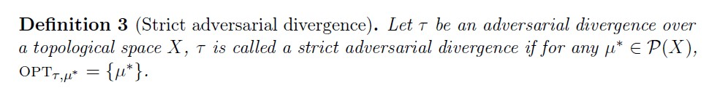
收敛性

Slide 6
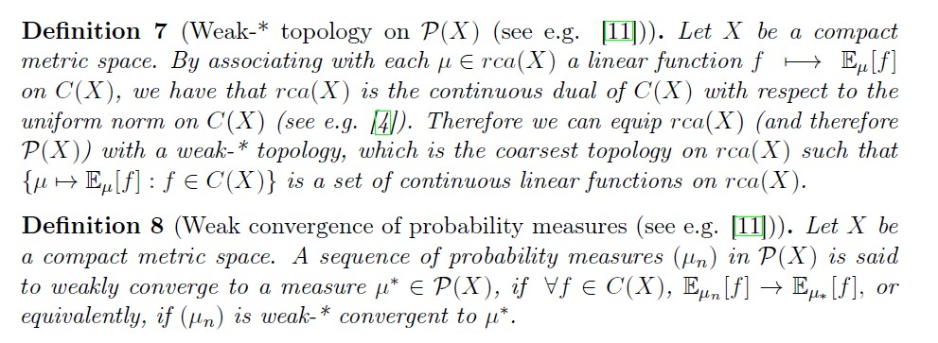
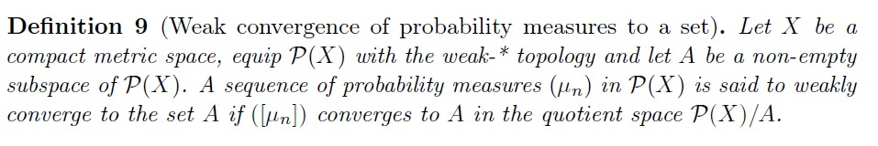
Notes:
rca(X) denote the set of finite signed regular Borel measures on X;
a Borel measure on a topological space is a measure that is defined on all open sets (and thus on all Borel sets)；
Let (X, T) be a topological space and let Σ be a σ-algebra on X. Let μ be a measure on (X, Σ).
A measurable subset A of X is said to be inner regular if μ (A)=sup { μ (F): F is a compact and measurable subset of A}
and said to be outer regular if μ (A)=inf{ μ (G): G is an open and measurable subset of A}
If a Borel measureμ is both inner regular and outer regular, it is called a regular Borel measure.
If μ is both inner regular and locally finite, it is called a Radon measure.
Now note that Definition 8 only defines weak convergence of a sequence of probability measures to a single target measure. Here we generalize the definition for the single target measure to a set of target measures through quotient topology as follows(definition 9).

Slide 7
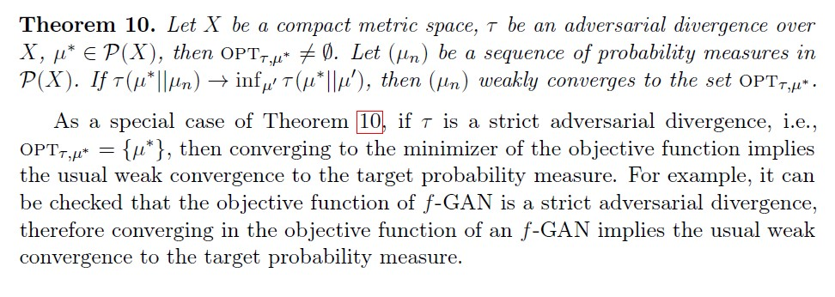
收敛性的结论

Slide 8
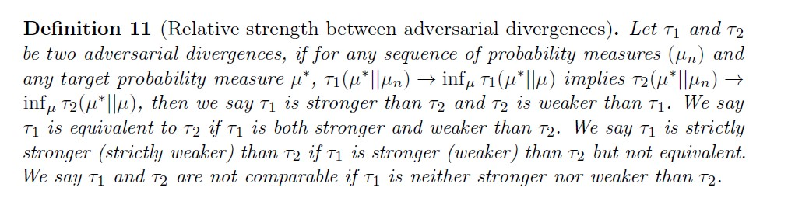
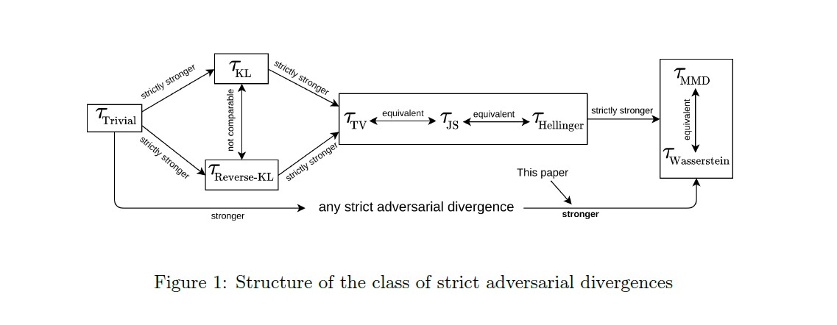
比较不同的 GAN对应的adversarial divergency
Notes:
$τ_{trivial}$(u||v) = 0, if u==v
=-inf, else
maximum mean discrepancy (MMD) seehttps://en.wikipedia.org/wiki/Kernel_embedding_of_distributions#Measuring_distance_between_distributions

Slide 9
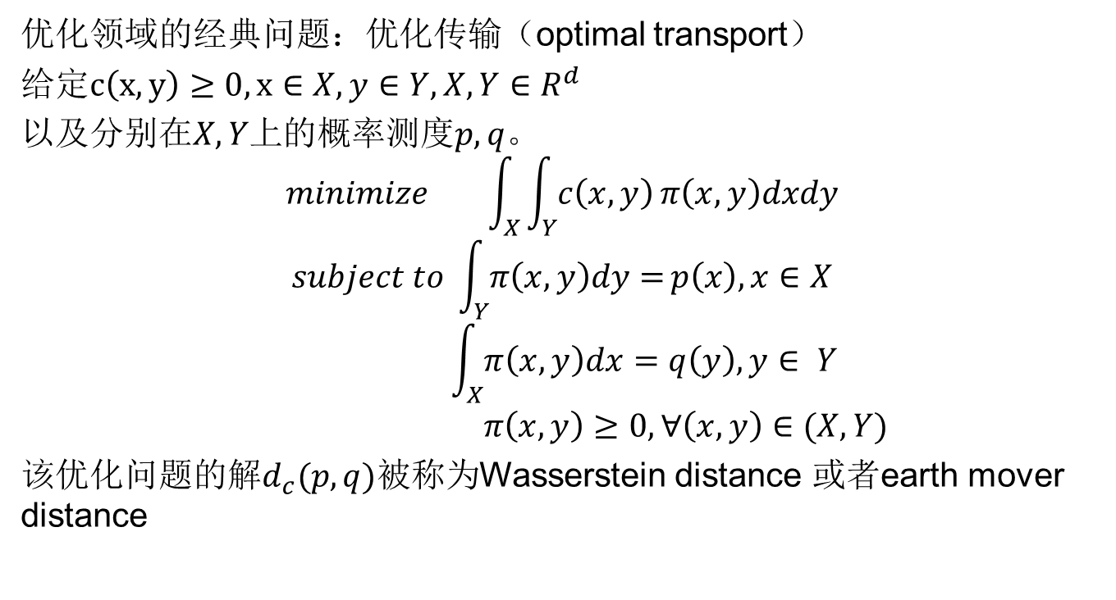
Wasserstein distance
优化领域的经典问题：优化传输（optimal transport）
给定$c\left(x,y\right)≥0,x∈X,y∈Y,X,Y∈R^{d}$
以及$分别在X,Y上$的概率测度$p,q。$
$$minimize \int_{X}{\int_{Y}{c\left(x,y\right)}π\left(x,y\right)dxdy}$$
$$subject to \int_{Y}{π\left(x,y\right)dy=}p\left(x\right),x∈X$$
$$\int_{X}{π\left(x,y\right)dx=q\left(y\right),y∈ Y}$$
$$π\left(x,y\right)≥0,∀\left(x,y\right)∈(X,Y)$$
该优化问题的解$d_{c}(p,q)$被称为Wasserstein distance 或者earth mover distance
Notes:
对于离散测度的情形，这就是一个线性规划问题。
我们可以有这样一个形象的理解：有n家面包店，第i家面包店的存货量为ai，现在它们要把面包配送给m个客户，第j位客户的需求量为bi。假设从第i家面包店运送至第j位客户的面包量为Pij，每单位面包的运输成本为cij。我们需要最小化将面包配送给客户的总成本。

Slide 10
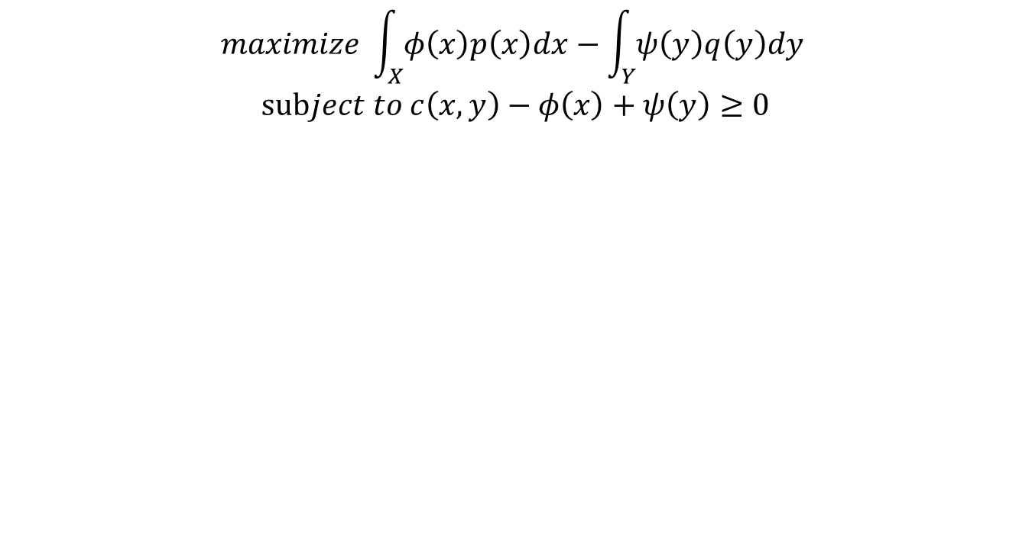
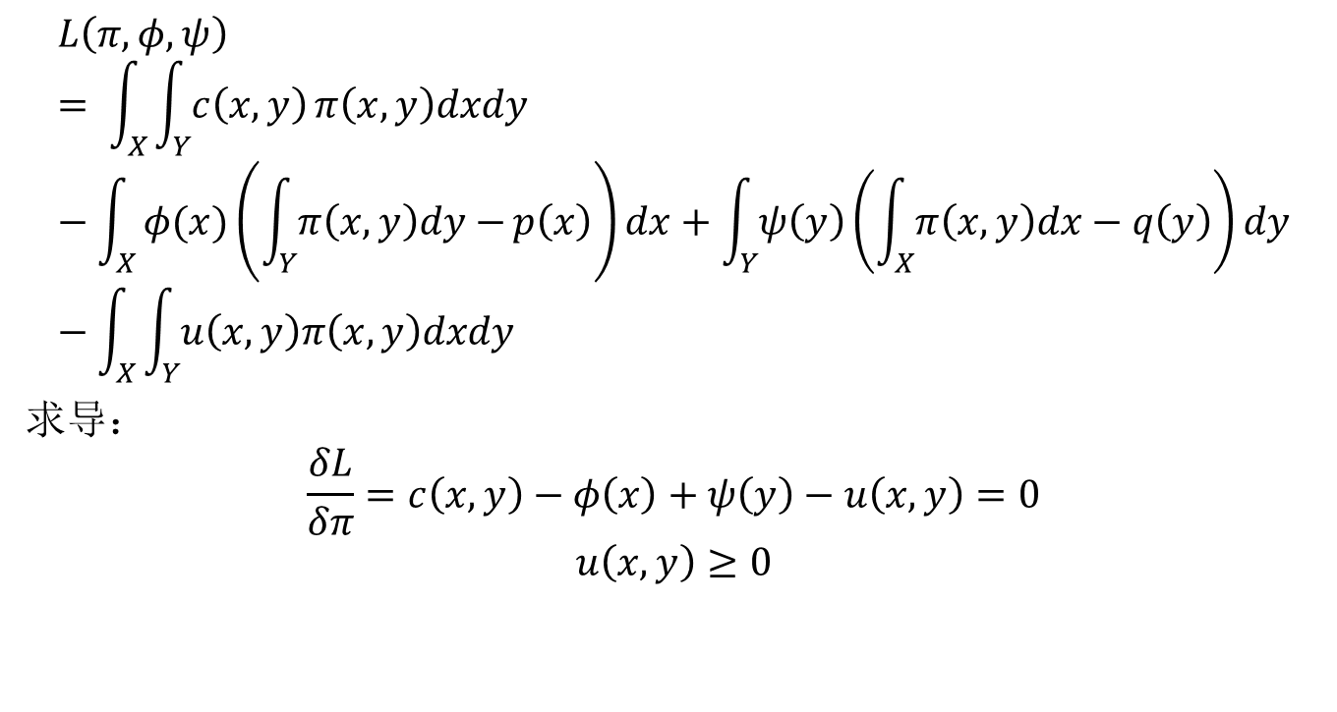
拉格朗日对偶
$$L\left(π,φ,ψ\right)= \int_{X}{\int_{Y}{c\left(x,y\right)}π\left(x,y\right)dxdy}−\int_{X}{φ(x)\left(\int_{Y}{π\left(x,y\right)dy−}p\left(x\right)\right)dx+\int_{Y}{ψ\left(y\right)}\left(\int_{X}{π\left(x,y\right)dx−q\left(y\right)}\right)dy}−\int_{X}{\int_{Y}{u\left(x,y\right)π\left(x,y\right)dxdy }}$$
求导：
$$\frac{δL}{δπ}=c\left(x,y\right)−φ\left(x\right)+ψ\left(y\right)−u\left(x,y\right)=0$$
$$u\left(x,y\right)≥0$$
对偶问题
$$maximize \int_{X}{φ\left(x\right)p\left(x\right)dx}−\int_{Y}{ψ\left(y\right)q\left(y\right)dy}$$
$$subject to c\left(x,y\right)−φ\left(x\right)+ψ\left(y\right)≥0$$
Notes:
Kantorovich-Rubinstein duality
对偶问题也有一个形象的理解：假设现在有了一家快递公司，快递公司将面包从面包店全部运往中转站，再从中转站运往各客户。快递公司向面包和客户分别收取运费，设第i面包店将一单位面包运往中转站的运费为fi而中转站将一单位面包运往第j位客户的运费为gj。对偶问题就是站在快递公司的角度，选择一种定价方案，使得赚取的运费最大化。
约束条件Cij >= ai + bj 地可以这样理解：如果cij < ai + bj ,那么相应的面包店和客户将不使用快递公司的服务，从而快递公司将失去这笔生意，也就是说这样的定价策略是不合理的。

Slide 11
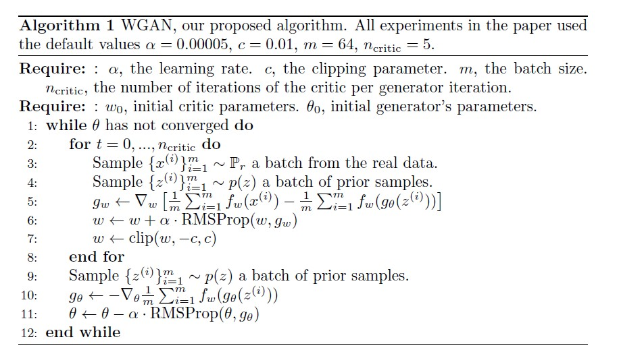
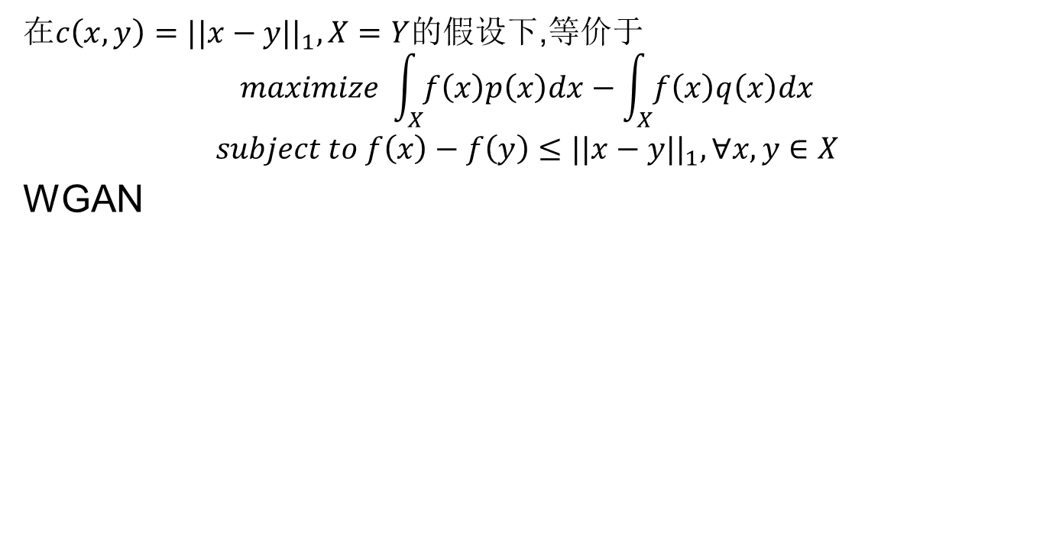
在$c\left(x,y\right)=||x−y||_{1},X=Y$的假设下,等价于
$$maximize \int_{X}{f\left(x\right)p\left(x\right)dx}−\int_{X}{f\left(x\right)q\left(x\right)dx}$$
$$subject to f\left(x\right)−f\left(y\right)≤||x−y||_{1},∀x,y∈X$$
WGAN
Notes:
Wasserstein WGAN

Slide 12
正则化
WGAN-GP
SWGAN
WGAN-ALP
DRAGAN

Slide 13
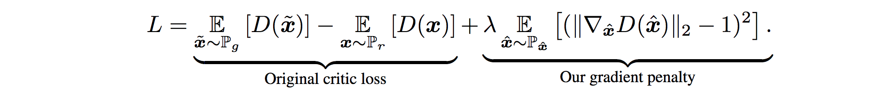
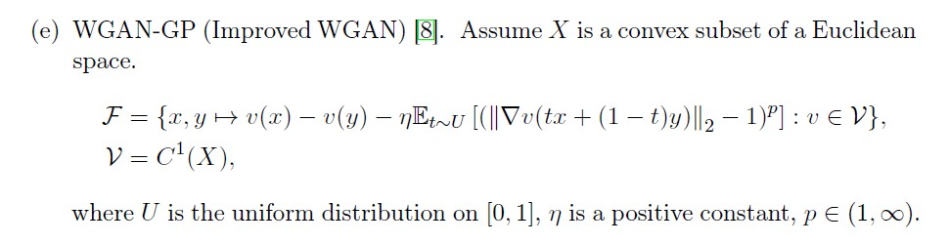
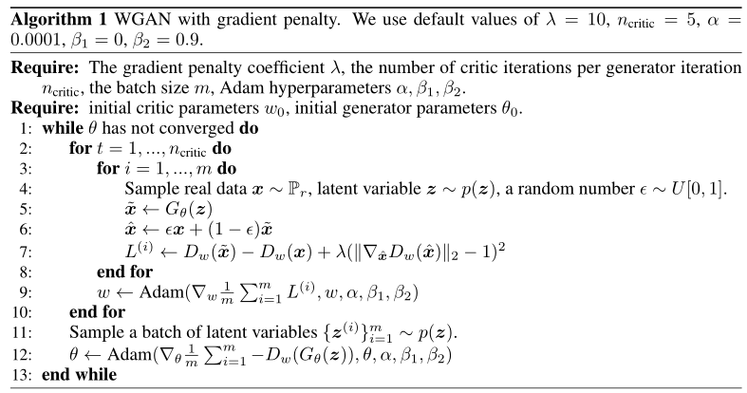
WGAN-GP(gradient penalty) adversarial divergency
Notes:
Improved Training of Wasserstein GANs
WGAN-GP在文章中指出了WGAN存在问题的原因，那就是WGAN在处理Lipschitz限制条件时直接采用了 weight clipping，就是每当更新完一次判别器的参数之后，就检查判别器的所有参数的绝对值有没有超过一个阈值，比如0.01，有的话就把这些参数 clip回 [-0.01, 0.01] 范围内。通过在训练过程中保证判别器的所有参数有界，就保证了判别器不能对两个略微不同的样本在判别上不会差异过大，从而 间接实现了Lipschitz限制。实际训练上判别器loss希望尽可能拉大真假样本的分数差，然而weight clipping独立地限制每一个网络参数的取值范围，在 这种情况下最优的策略就是尽可能让所有参数走极端，要么取最大值（如0.01）要么取最小值（如-0.01），文章通过实验验证了猜测如下图所示判别器的参数几乎都集中在最大值和最小值上。
注意：由于模型是对每个样本独立地施加梯度惩罚，所以判别器的模型架构中不能使用Batch Normalization， 因为它会引入同个batch中不同样本的相互依赖关系。

Slide 14
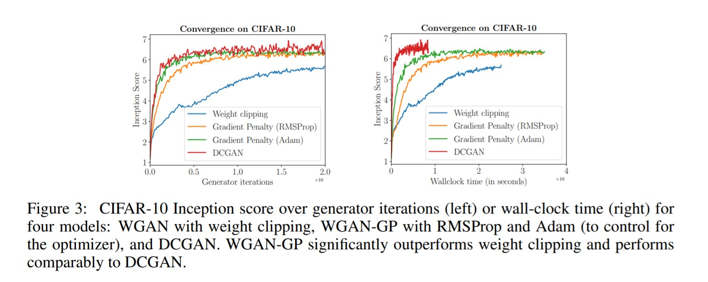
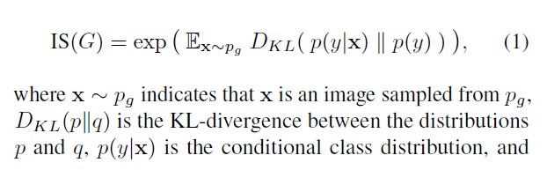
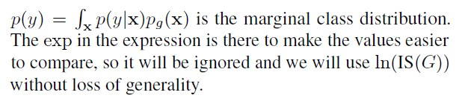
Inception score
Notes:
A Note on the Inception Score(link: https://arxiv.org/pdf/1801.01973.pdf)
Inception score越大越好

Slide 15
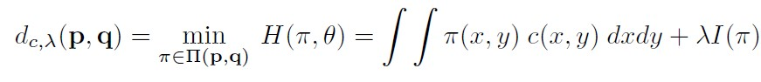
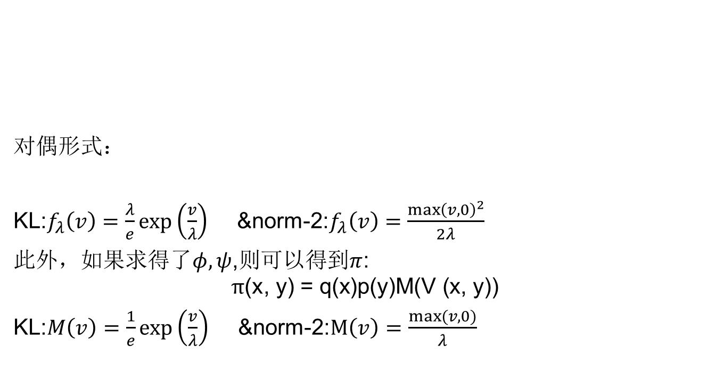
Smoothed WGAN (SWGAN)
对偶形式：
KL:$f_{λ}\left(v\right)=\frac{λ}{e}\exp\left(\frac{v}{λ}\right)$ &norm-2:$f_{λ}\left(v\right)=\frac{{\max\left(v,0\right)}^{2}}{2λ}$
此外，如果求得了$φ,ψ$,则可以得到$π$:
$$π\text{(}\text{x}\text{, }\text{y}\text{) = }\text{q}\text{(}\text{x}\text{)}\text{p}\text{(}\text{y}\text{)}\text{M}\text{(}\text{V}\text{ (}\text{x}\text{, }\text{y}\text{))}$$
KL:$M\left(v\right)=\frac{1}{e}\exp\left(\frac{v}{λ}\right)$ &norm-2:$M\left(v\right)=\frac{max⁡(v,0)}{λ}$
Notes:
On the Convergence and Robustness of Training GANs with Regularized Optimal Transport

Slide 16
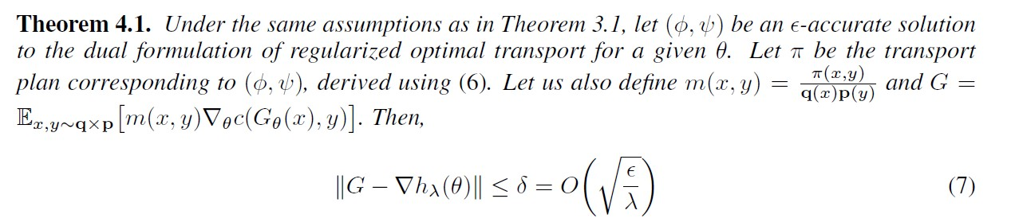
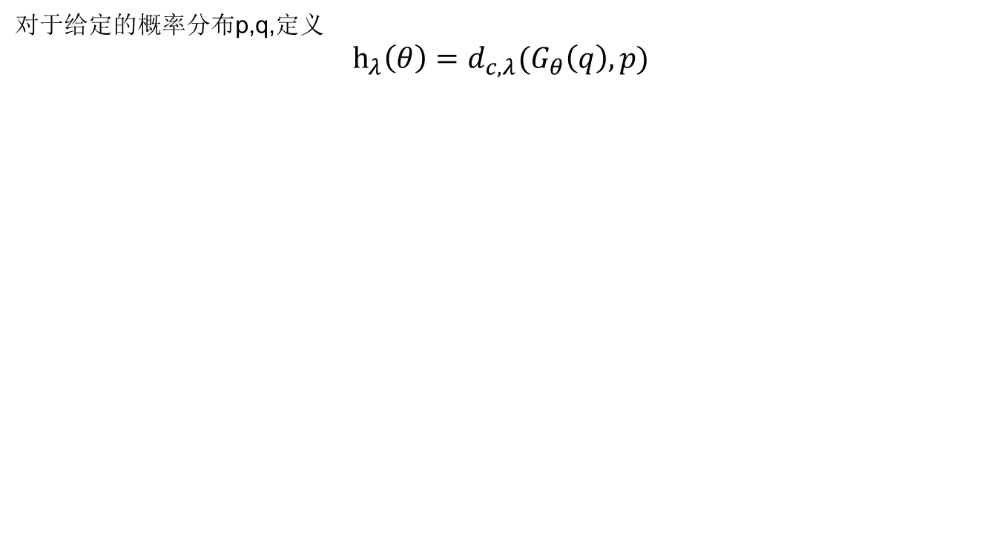
对于给定的概率分布p,q,定义
$$h_{λ}\left(θ\right)=d_{c,λ}(G_{θ}\left(q\right),p)$$
Notes:
这意味着我们可以用G来近似梯度$∇h_{λ}(θ)$

Slide 17
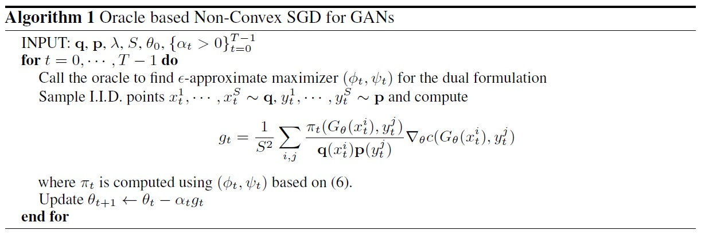
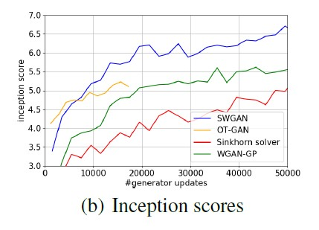
On the Convergence and Robustness of Training GANs with Regularized Optimal Transport一文提出SWGAN模型
On CIFAR-10
Notes:
OT-GAN: https://arxiv.org/abs/1803.05573
它的代价函数$c(x,y)$是一个神经网络$c(g\left(x\right),h\left(y\right))$

Slide 18
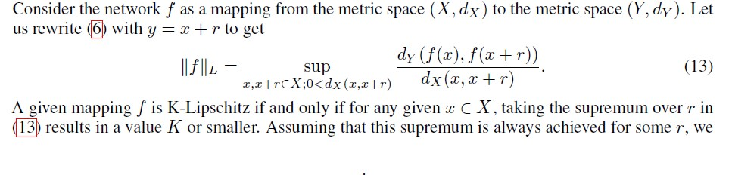
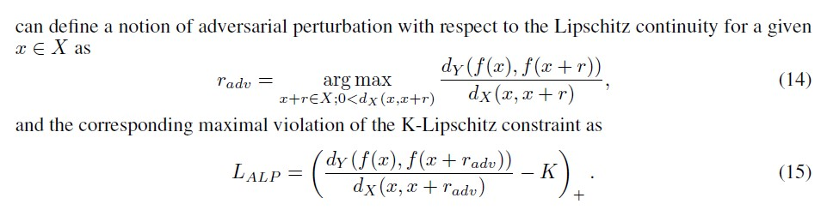
WGAN-ALP(Adversarial Lipschitz Penalty)
Adversarial Lipschitz Regularization一文改进WGAN-GP的正则项
We define Adversarial Lipschitz Regularization (ALR) as the method of adding (15) as a regularization term to the training objective that penalizes the violation of the Lipschitz constraint evaluated at sample pairs obtained by adversarial perturbation. We call this term Adversarial Lipschitz Penalty (ALP).
Notes:
Adversarial Lipschitz Regularization

Slide 19
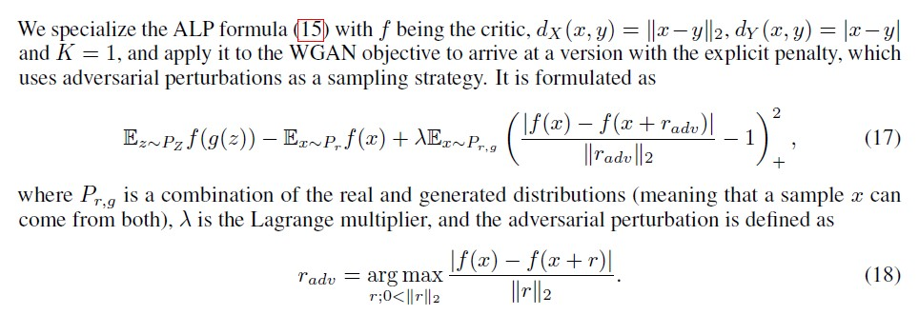
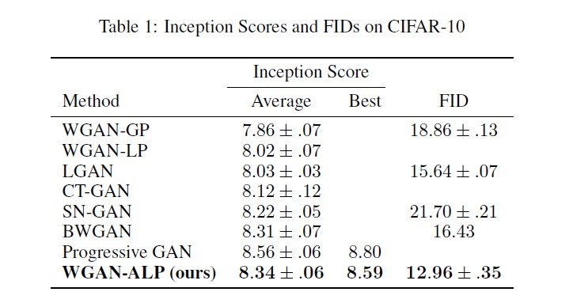
WGAN-ALP
Notes:
该文声称
In this work, we focus on applying ALR to Wasserstein GANs, as regularizing or constraining Lipschitz continuity has proven to have a high impact on training stability and reducing mode collapse.

Slide 20
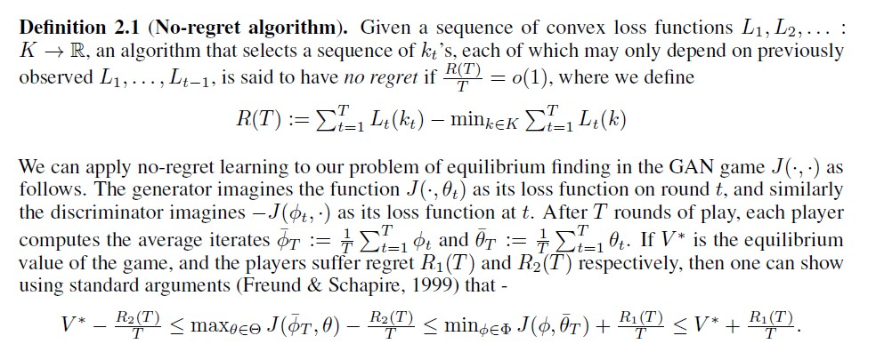
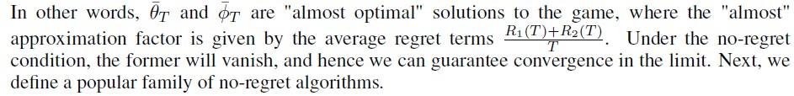
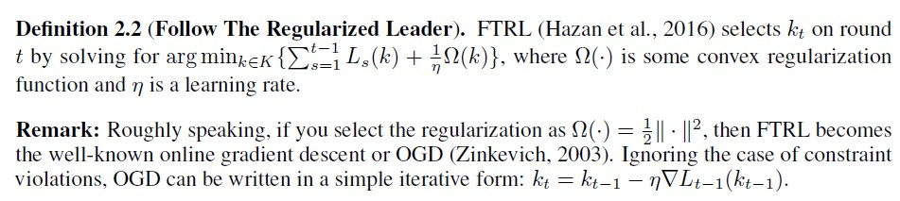
DRAGAN (Deep Regret Analytic)
Notes:
ON CONVERGENCE AND STABILITY OF GANS （2017）Naveen Kodali, Jacob Abernethy, James Hays & Zsolt Kira
本文从博弈（game）的角度解释GAN，其主要思路是这样：
We hypothesize the existence of undesirable local equilibria in this non-convex game to be responsible for mode collapse. We observe that these local equilibria often exhibit sharp gradients of the discriminator function around some real data points. We demonstrate that these degenerate local equilibria can be avoided with a gradient penalty scheme called DRAGAN

Slide 21
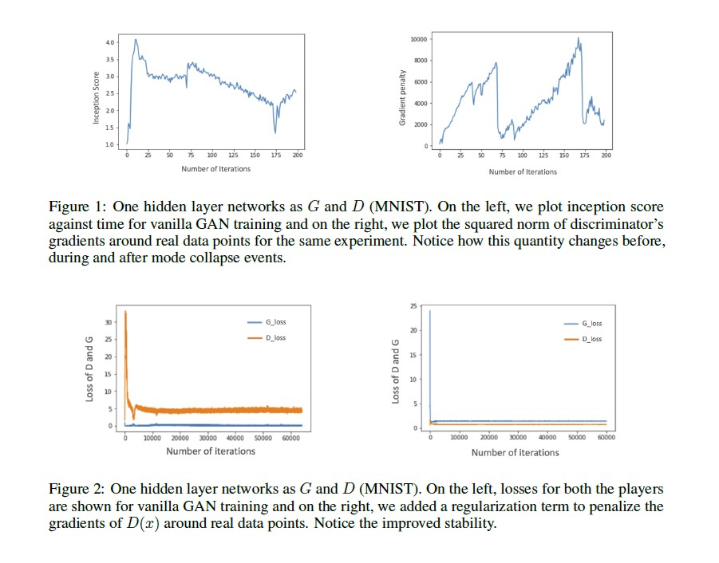
DRAGAN
Add penalty to WGAN’s loss:
Notes:
x+$δ$ are likely to lie off the data-manifold, which is true in the case of image domain and some other settings. Because, in these cases, we
do want our discriminator to assign different probabilities of being real to training data and noisy samples.
可以理解为添加了噪声使得学习更加稳定
本文中也把其网络成为vanilla GAN

Slide 22
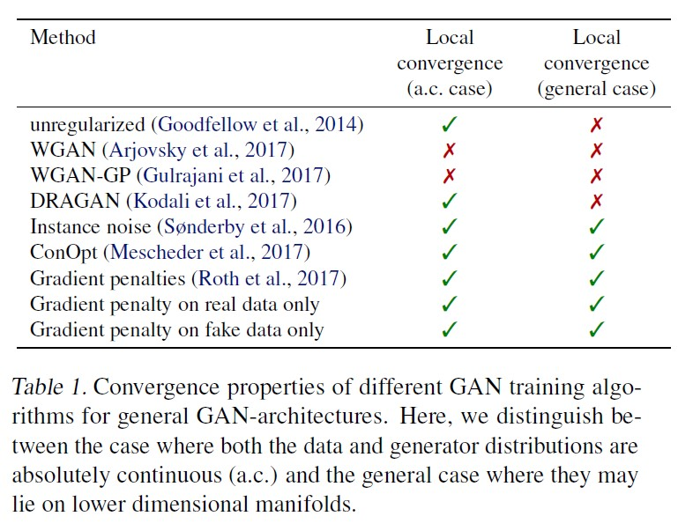
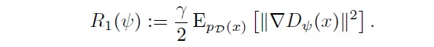
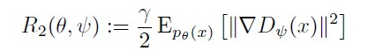
Which Training Methods for GANs do actually Converge?
Our analysis shows that GAN training with instance noise or zero-centered gradient penalties converges.
Gradient penalty：
Notes:
Which Training Methods for GANs do actually Converge?
该文声称 :
While we find that unregularized GAN training quickly leads to mode-collapse for these problems, our simple R1-regularizer enables stable training

Slide 23
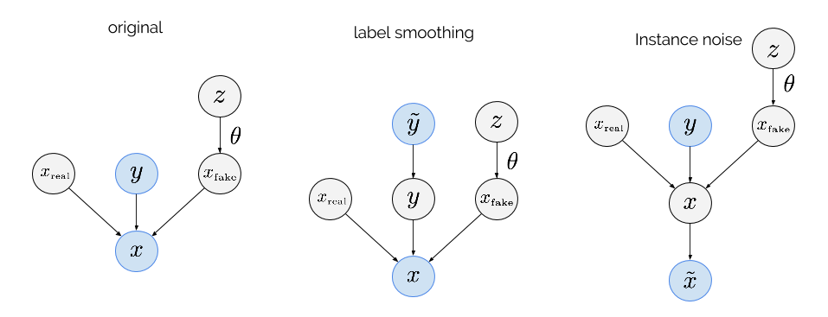
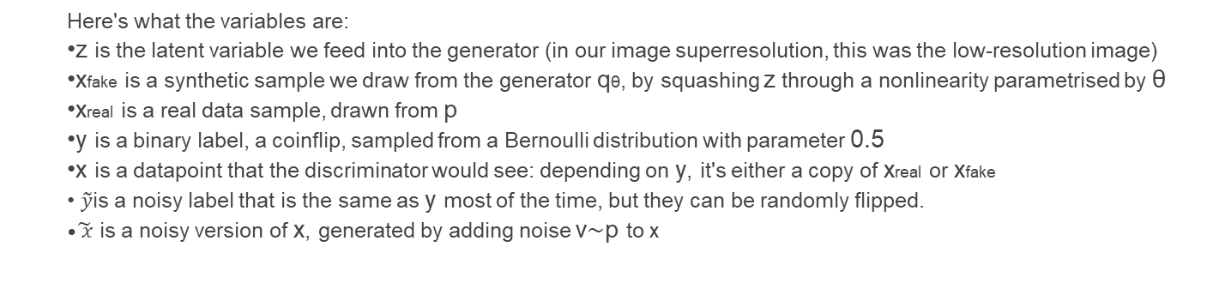
Instance noise
Here's what the variables are:
z is the latent variable we feed into the generator (in our image superresolution, this was the low-resolution image)
xfake is a synthetic sample we draw from the generator qθ, by squashing z through a nonlinearity parametrised by θ
xreal is a real data sample, drawn from p
y is a binary label, a coinflip, sampled from a Bernoulli distribution with parameter 0.5
x is a datapoint that the discriminator would see: depending on y, it's either a copy of xreal or xfake
$\tilde{y}$is a noisy label that is the same as y most of the time, but they can be randomly flipped.
$\tilde{ x}$ is a noisy version of x, generated by adding noise ν∼p to x
Notes:
Instance Noise: A trick for stabilising GAN training (link: https://www.inference.vc/instance-noise-a-trick-for-stabilising-gan-training/)
Amortised MAP Inference for Image Super-resolution(link: https://arxiv.org/abs/1610.04490)
label smooth: 故意给Discriminator错误的标签，它会认为这fake的数据，从而增加了Discriminatory的工作难度。

Slide 24
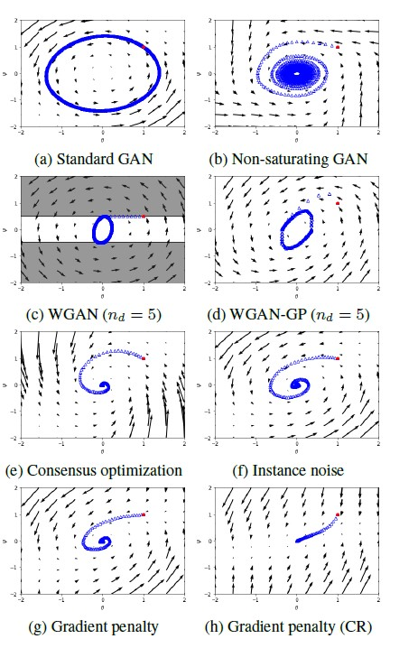
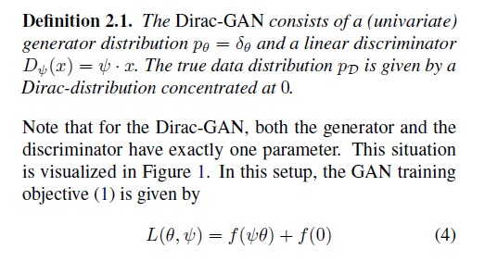
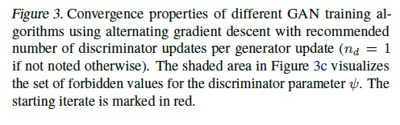
Dirac-GAN
Notes:
Which Training Methods for GANs do actually Converge?一文中构造了一个简单的架构：Dirac-GAN，并证明了WGAN、WGAN-GP在Dirac-GAN上不收敛。
在CIFAR-10上做的实验用网络为：Discriminator：3*conv2d+1*reshape+1*fc；Generator：1*fc+1*reshape+3*deconv2d

Slide 25
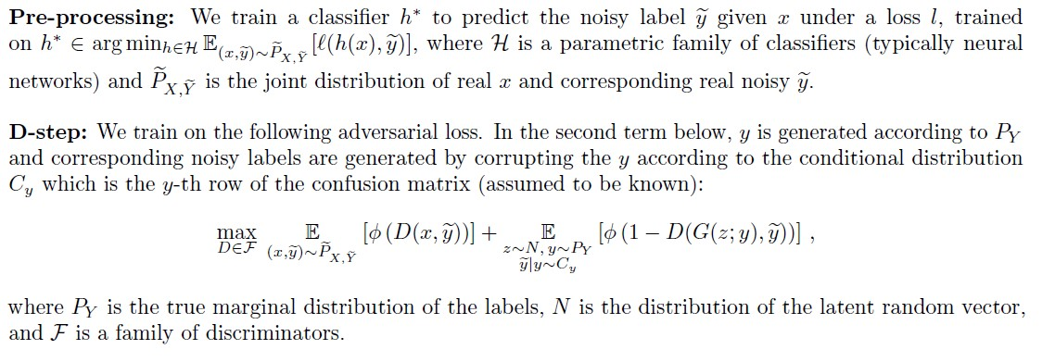
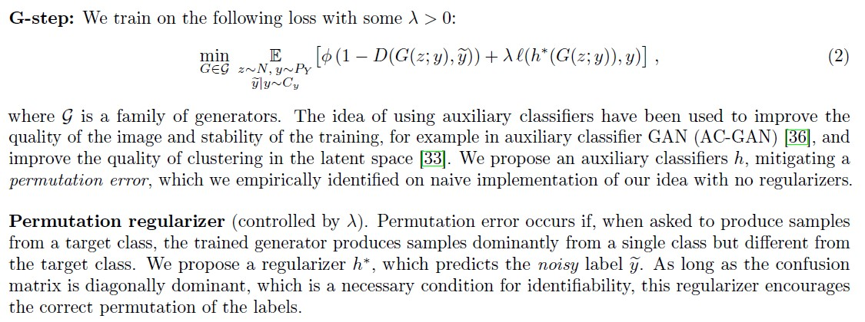
RCGAN(robust conditional GAN)
Notes:
Robustness of Conditional GANs to Noisy Labels
这里$λ=0$就是标准的conditionalGAN

Slide 26
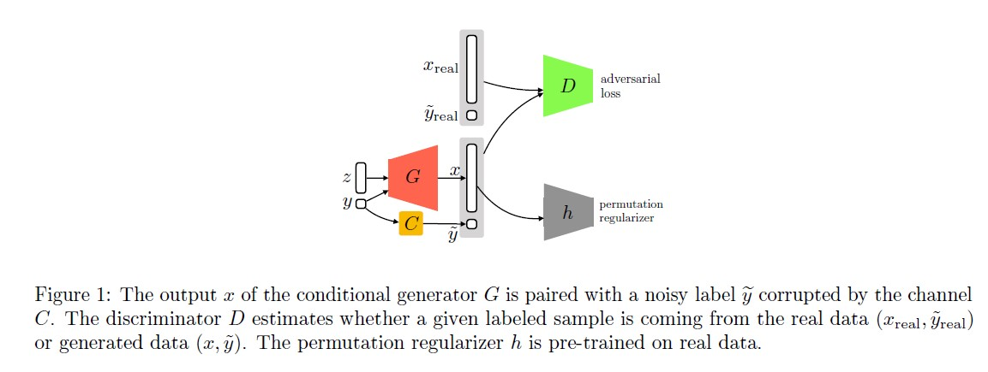

Slide 27
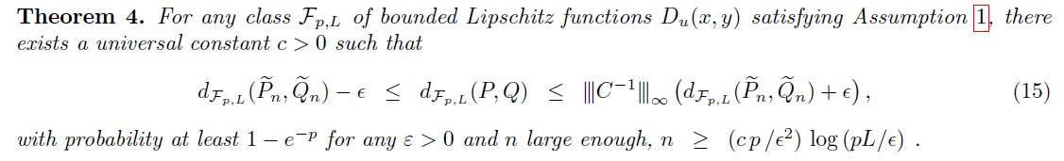
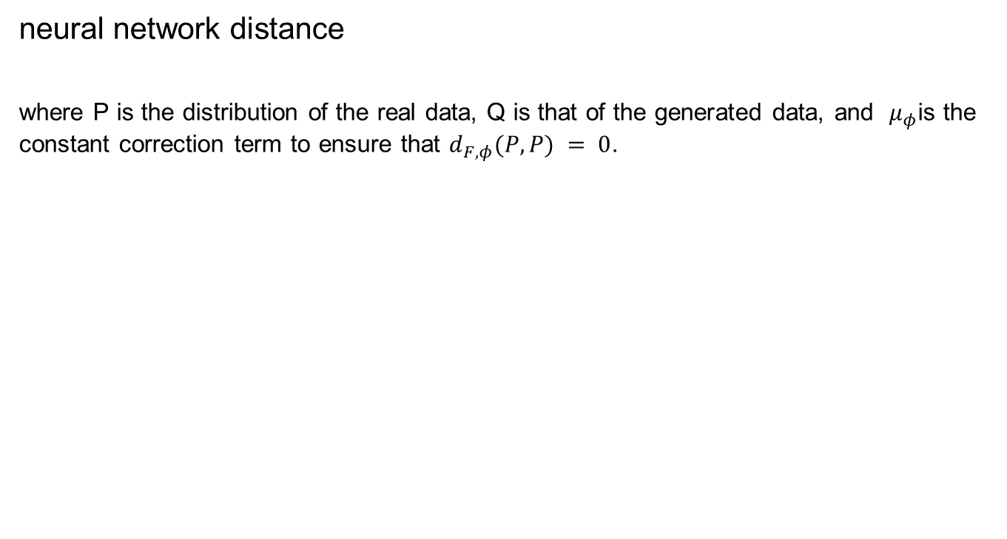
neural network distance
where P is the distribution of the real data, Q is that of the generated data, and $μ_{φ}$is the constant correction term to ensure that $d_{F,φ}(P, P) = 0$.
Notes:
Let P, Q be two distributions on X, Y and be Pn, Qn be empirical versions of them with at least n samples each.

